Slide 1
Town of Lake Lure Chimney Rock Village
Market Study Findings
October 23, 2012

Slide 2
This Evening’s Presentation
Input Summary
Zip Code Results
Market Definition
Trade Area Definition
Retail Leakage Study
Preliminary Observations
Next Steps

Slide 3
Input Summary: Assets
Two very distinct communities.
Unspoiled beauty.
Unique history.
Tranquility/slower pace.
Chimney Rock Village CDA.
Olympiad.
The Gathering Place.
River Walk.
Lake.

Slide 4
Input Summary: Assets
Proximity to major metro areas: first mountain community.
Affordability.
Not “generic” or corporate.
Small town feel/rustic/scenic retreat.
Dirty Dancing/Last of the Mohicans
Picking in Lake Lure.
Accommodations are up with some properties.
Micro-climate, late peak leaf season, milder.

Slide 5
Input Summary: Assets
Nostalgia.
Lake Lure Classical Academy.
Ingles.

Slide 6
Input Summary: Opportunities
Change of entrance of Chimney Rock Park
Telecommuters
Better connect both communities.
Better connect region.
Build stronger partnerships with TDA, HNG Chamber, Rutherford County.
Grow to market outdoor activity particularly climbing.
Use LL/CRV as jumping off point for whole region.

Slide 7
Input Summary: Opportunities
Better events to extend the season: Holiday event, bring back old events.
Better online presence.
Flowering bridge will be great draw.
Bottomless pools need to be re-opened.
Capitalize on “Lake Como” image.
Convert day trippers into overnight visitors.
Leverage the arts as an attractor to the community.

Slide 8
Input Summary: Challenges
LL does not live up to its “promise” as a destination: many comments regarding the management and policies related to the lake itself.
Overrated as a destination.
Not enough to do.
Lack of dining options.
No alcohol in CRV.
Need for better internet service.
Poor business environment.

Slide 9
Input Summary: Challenges
Lack of housing variety.
Lack of accommodation variety.
Disengagement of Rumbling Bald with rest of community.
Lack of chain restaurants that are family friendly.
Bikers: sound, image, behavior.
Poor upkeep of vacant buildings.
Poor renter return ratio.
Too adult oriented, not family friendly.

Slide 10
Input Summary: Challenges
Hard to sustain 18 restaurants with current population.
No nightlife.
Closing off the river access was unpopular with some.
TDA does not invest appropriate amount of money in the area.
LL has tilted its policies toward the residents by design sometimes at the expense of the visitor.

Slide 11
Input Summary: Threats
Over-development like what happened in Florida.
Very unfriendly approach: many signs saying what you can’t do few saying what you can do.
No-growth agenda on the part of some residents.
Don’t look for silver bullet answer: large development (casino).
Lack of clarity on what the communities want to be.

Slide 12
Input Summary: Needs and Wants
Need vacationers to survive as a community: lifeblood of the community.
More mountain biking trails.
Fishing spots for families.
Trail system.
Family camping.
Remove Billboards.
Remove utilities.
Maintain “feel” of CRV and LL.
Vibrant visitor center.

Slide 13
Input Summary: Needs and Wants
Wayfinding signs.
Summer art camp.
Street theatre.
Vacation packages.

Slide 14
Input Summary: Quotes
“In the center of everything, in the middle of nowhere”
“Mayberry on the Lake”
“We are conjoined twins that are much better together”

Slide 15
Market Analysis - Zip Code Survey
First survey Held August 2012
24 Participants Tallied (19 CRV and 5 LL)
2436 Recorded Visits
1121 Unique American Zip Codes
41 States DC and 10 Foreign Countries

Slide 16
Zip Comparisons

Slide 17
State Comparisons

Slide 18
Where are they from?

Slide 19
Characterization of Visit

Slide 20
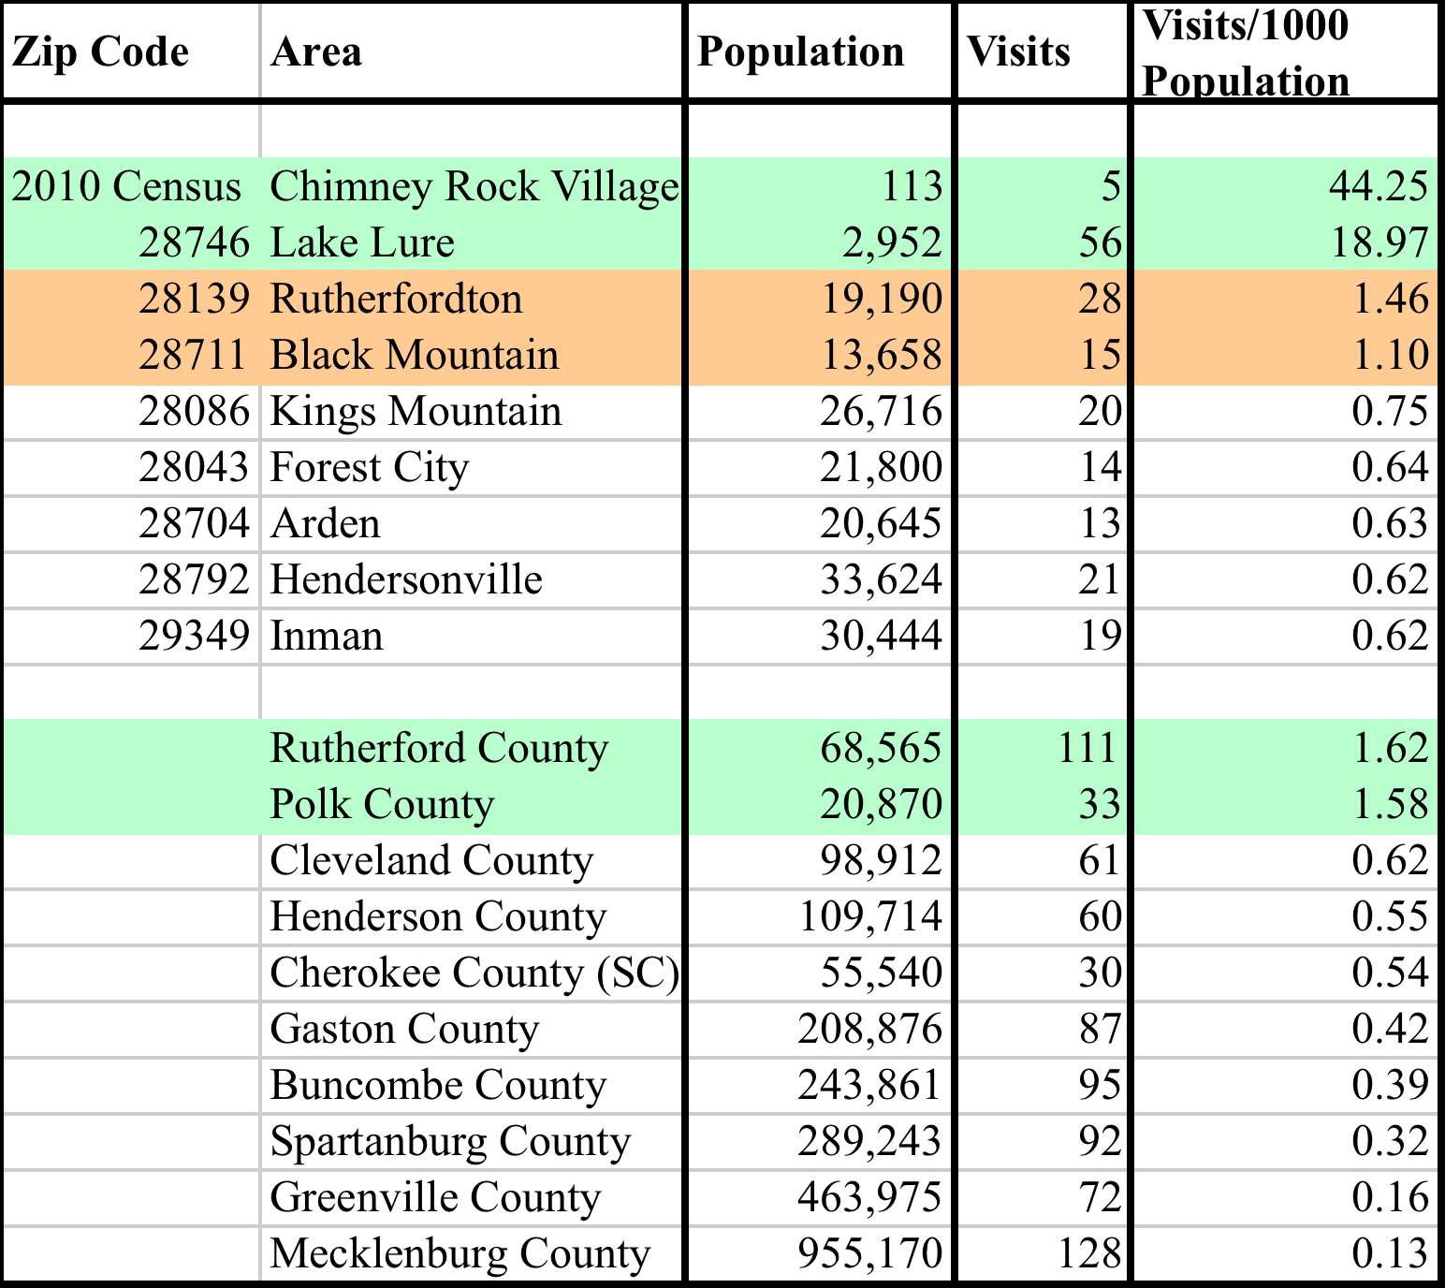
The Trade Area Definition

Slide 21
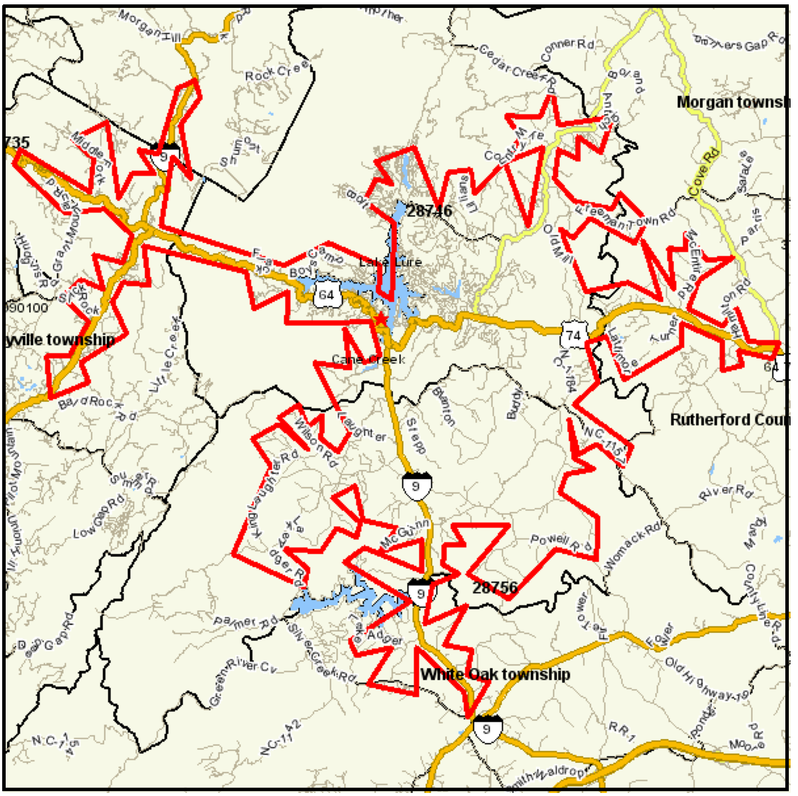
Another Look at the Trade Area
Notes:
Claremont med age is 40, med hh income is 47K
PTA 132K HH value STA 168k HH value
Pull down second home market data.

Slide 22
Trade Area Demographics
16 minute drive time permanent population is estimated at 4,293.
Grew by 20.2% since 2000 and expected to continue to grow by 2016.
Median age is 47 and 53% of the population is over 45 (significantly older than surrounding areas)
Median HH Income is $38,748 (significantly lower than surrounding areas).
Median Owner Occupied Home Value $173,791 which is lower than Henderson and Buncombe.
Owner Occupied 83% Renter Occupied 17%***
Notes:
22

Slide 23
Retail Leakage Study
A study to establish the retail dollars leaving or entering a community from its primary and secondary trade areas. This is more art than science.
Notes:
23

Slide 24
16 Min. Trade Area Statistics
PTA Selected Store Sales $34.6 million
PTA Consumers spent $65.1 million
Trade Area is LEAKING $30.5 million annually.
Trade Area is only gaining in five categories:
Grocery Store Sales $2.5 million
Gift Stores $.9 million
Full Service Restaurants $2.0 million
Limited Service Restaurants $6.3 million
Liqour Stores $.4 million
Notes:
24

Slide 25
Leakage Opportunities
Pharmacy $4.4 million
Building/Hardware/Garden Center $5.0 million
Gas Stations $4.3 million
Clothing/Accessories $2.3 million
General Merchandise $4.5 million
Limited and focused specialty retail $1.0 million
Notes:
25

Slide 26
Preliminary Observations (Input)
The communities are in a state of flux – the “no change” option is not an option.
Chimney Rock has cultivated a distinct image that is clearly articulated, Lake Lure’s image is less clear.
Both communities send mixed messages about how welcome a visitor is (signs/regulations).
There are untapped markets to the region that could be capitalized upon.
There is little to no coordinated marketing between the two communities as complementary.
Notes:
26
Community events, expand.

Slide 27
Preliminary Observations (Input)
Very poor visitor web presence.
Confusing message about the Lake and River access.
Lake Lure has unrealized potential but the policy tilt has been resident-centric.
There isn’t just one strategy cultivating residential growth AND visitor growth is essential for success.
Notes:
27

Slide 28
Preliminary Observations (Data)
Lake Lure and Chimney Rock are the most visitor oriented markets we have ever studied.
The local population cannot sustain the existing merchandise mix – it is entirely dependent on visitors.
If the visitor market is not cultivated, the local retail and restaurant market will continue to churn – some will survive others will not.
The local population, however, is not being served in critical retail areas that could be successful.
Notes:
28

Slide 29
Preliminary Observations (Data)
The local market skews older and earns less than Henderson County and Buncombe County.*
The market for the communities is very broad (flat) which is difficult to pinpoint from a marketing standpoint.
The overnight visitor is under-recognized as a driver of the economy.
There is NO browsing activity between Lake Lure and Chimney Rock though there is significant browsing in Chimney Rock itself.
Notes:
29

Slide 30
Next Steps
Feedback and Questions.
Branding workshop November 27-29
Tally second zip code survey.
Individual business reports for participating businesses.
Develop implementation recommendations.
Develop implementation matrix.
Notes:
30

Slide 31
Input
Notes:
31

